Slide 1


Presentation on the B. Tech. Term Project
Gollu Jikki Sravanthi
19me31010

Slide 2

Predicting Reading Comprehension from Gaze Behavior using supervised learning techniques
Pranav Teja sir Contact No – 90832-03444

Slide 3
Introduction
People generally move their eyes in a prevailing way while reading a text where they act differently based on their understanding of the text or passage
Eye movements can reflect cognitive processes like viewing, searching, reading, and thinking.
An attempt to decode the individual's behavior from the readings of their eye movements.
Few of the researches are focused on predicting a person’s state during reading and their level of understanding of the text read.
We try to use supervised learning models like Decision Tree, Random Forest, K-Nearest Neighbor and Naive Bayes to predict the reader's difficulty level and nativity from eye fixations and fixation durations.
We try different approaches to classify the related variables, the difficulty of reading, and whether the reader's first language is English.
Fixation data is collected from eye-tracking data of 95 participants who read SAT practice passages

Slide 4
Data
The eye movements of 95 participants reading four SAT passages are recorded
Consists of answers to comprehension and self-evaluation questions like the difficulty of understanding.
Data are collected from the SAT dataset available publicly at https://github.com/ahnchive/SB-SAT.
The fixations were parsed from the gaze coordinates.
Focuses on the sequences of 21 fixation-location (x, y), fixation duration, and features of the pupil size extracted from the dataset.
The responses of the participants decide the level of difficulty of the passages.
It is observed that people with higher understanding levels made shorter fixation durations and had a faster reading rate.
The people who rated the difficulty as hard tended to read slowly and had more extensive fixation durations than others.

Slide 5
Pre-processing
The labels of the datasets are stored, and the corresponding information from the tables is changed to 0 or 1, according to the half they belong, to separate the high and low levels.
The main four oculomotor features - Current fixation of X, Current fixation of Y, Current fixation of Pupil size, and Current Fixation Duration from each data are normalized to values between 0 and 1.
The data retrieved is grouped into a window of consecutive fixations and fixation durations, without overlaps, to pass them as inputs for the model training.
The labels for the data are inherited directly from the label of the passage from which the window came and label of that particular individual.
After slicing the four primary columns from the original eye-tracking data, they are assigned the individual's name and the passage using the function generate_window.

Slide 6
The predictions from the fixations are made in three different manners:
Predicting on New Reading Windows (Record wise):
New windows mean the model has just seen those data.
The original dataset of 2,63,032 samples is randomly divided into three proportions of 80% for training, 10% for validation, and 10% for testing datasets.
Predicting on New Passages (Book wise):
To predict if the model could generalize from new passages.
The dataset is divided into three proportions, where two passages are randomly allocated for the training dataset, one passage for validation, and one passage is left for testing the model.
Random splits are generated for different readers.
Predicting on New Readers (Subject wise):
To test whether the model could be generalized for new readers.
The preliminary dataset of 95 participants is again split into three proportions. 80% of 95 participants, i.e., 76 participants' windows, are included in the training dataset, 10%, i.e., 10 participants' windows in the validation dataset, and the rest, 9 participants' windows in the testing dataset.
The comprehension levels for the unseen 9 participants are predicted after training.

Slide 7
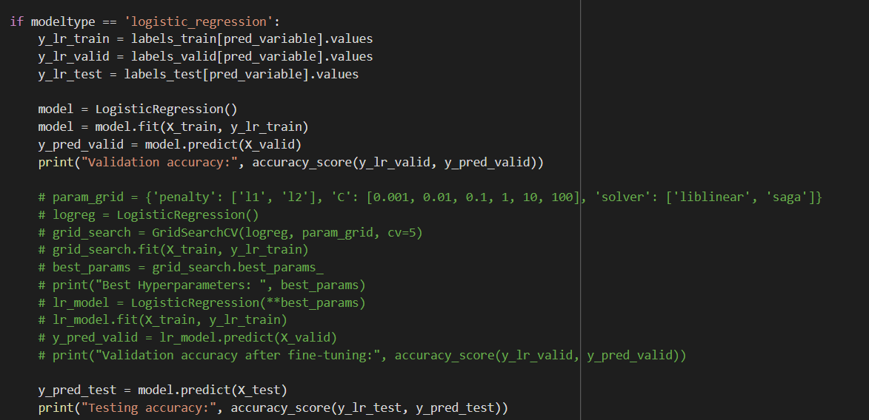
Model
Null Model is calculated for a lower bound. The null accuracy is calculated from the maximum occurrence of the weights in the testing dataset.
The supervised machine learning models or classifiers are used to predict the accuracies of validation and testing datasets.
The validation datasets are fine-tuned using GridSearchCV
to derive the best parameters of the model for
best possible accuracies of the given data.
Logistic Regression:
statistical model, commonly used to analyze
binary outcomes.
The model is loaded and used
to predict the validation and testing accuracies.

Slide 8
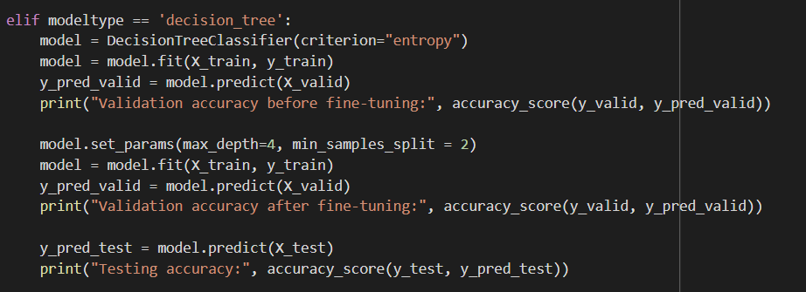
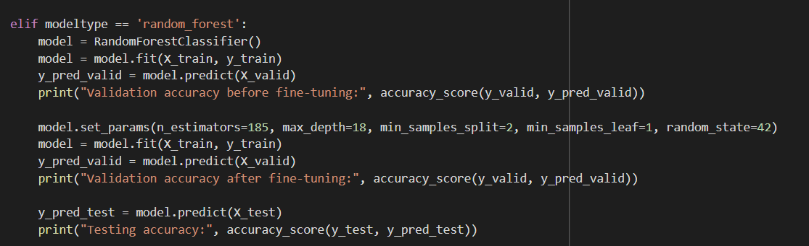
Decision tree:
classification and regression problems but mainly classification problems.
classifier is a tree structure, where internal nodes represent features, branches represent the decision taken, and each leaf node represents the outcomes.
Best_params_ = max_depth, min_samples_split
Random forest:
classification and regression problems.
multiple classifiers are combined to solve a complex problem and improve its performance.
contains a number of decision trees and takes average to improve the predicted accuracy.
Best_params_ = n_estimators, max_depth, min_samples_split, min_samples_leaf, random_state

Slide 9
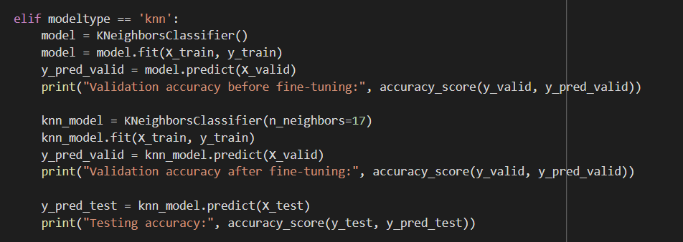
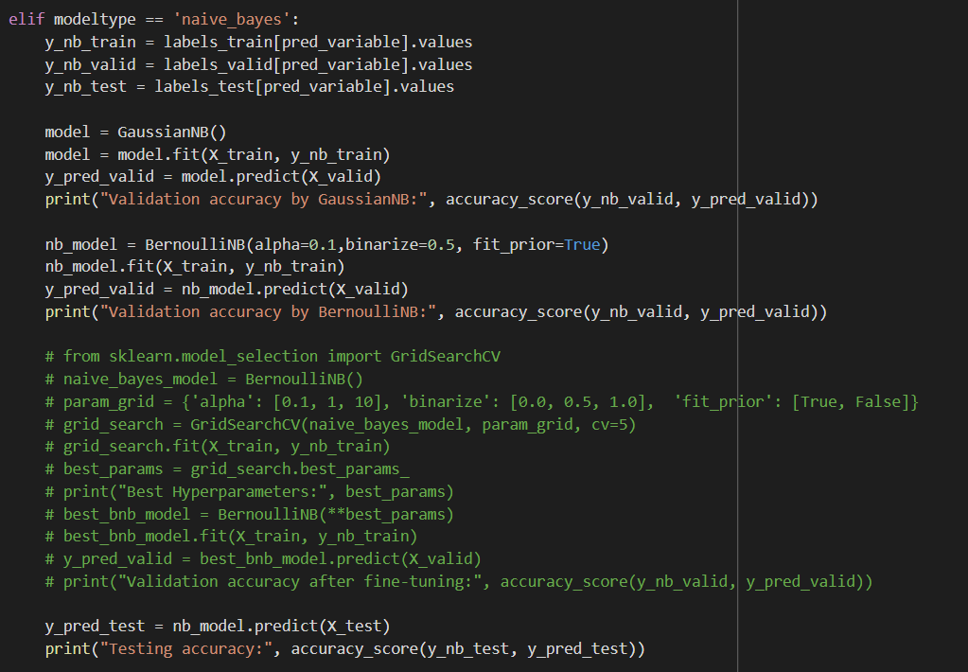
K – nearest neighbour:
assumes similarity between available data and new data and classifies the new data into a category most similar to the available ones.
regression and classification problems but primarily for classification.
stores the dataset and performs an action on the dataset at the time of classification.
Best_params_ = n_neighbors
Naïve Bayes:
to solve classification problems.
includes a high-dimensional training dataset.
make quick predictions based on an object's probability
Gaussian Naive Bayes classifier and Bernoulli Naive Bayes classifier are used.

Slide 10
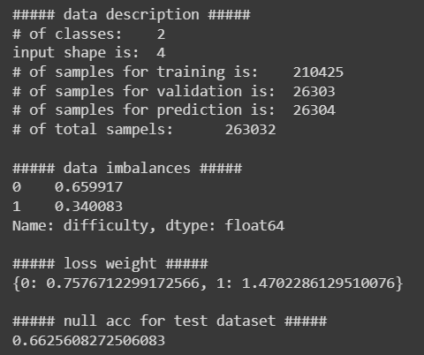
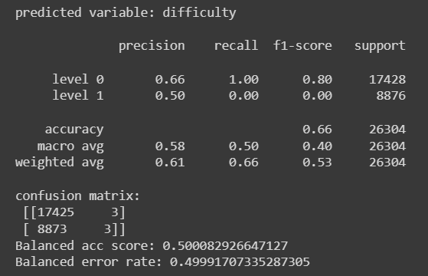
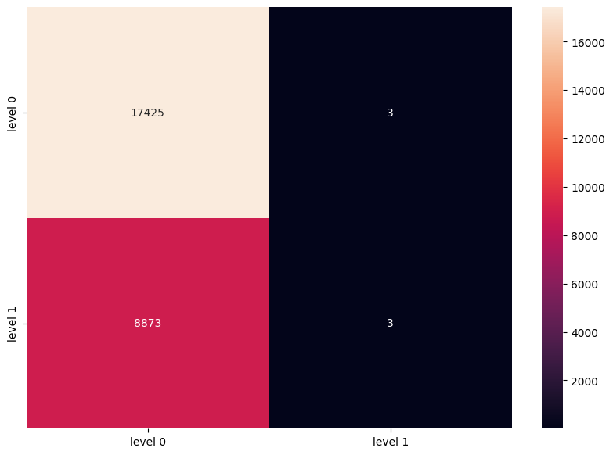
Predicting on New Reading Windows (Record wise)
For Difficulty
Null Accuracy = 0.66%
Logistic Regression = 0.66%

Slide 11
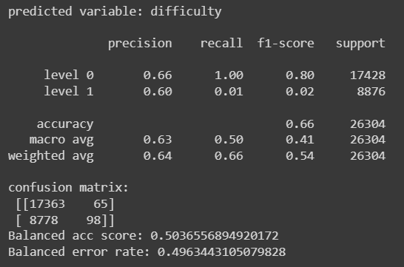
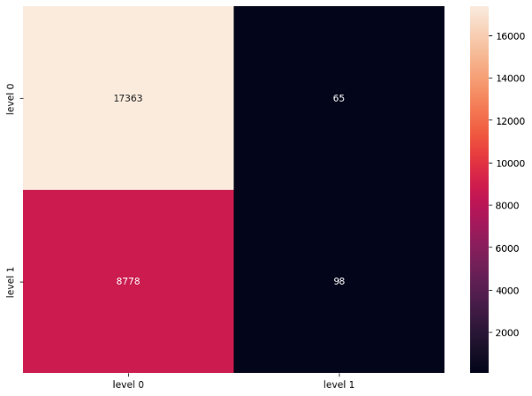
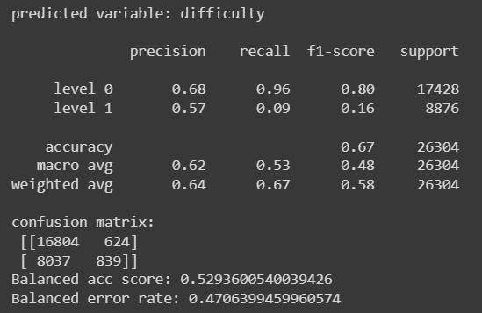
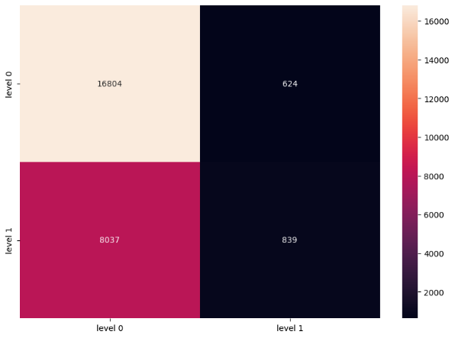
Decision tree = 0.66%
Random forest = 0.67%

Slide 12
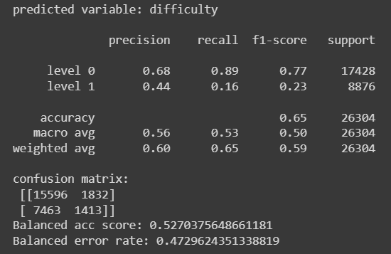

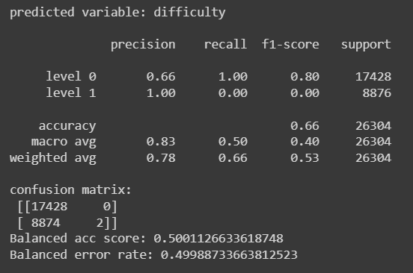

K – nearest neighbour = 0.65%
Naïve Bayes = 0.66%

Slide 13
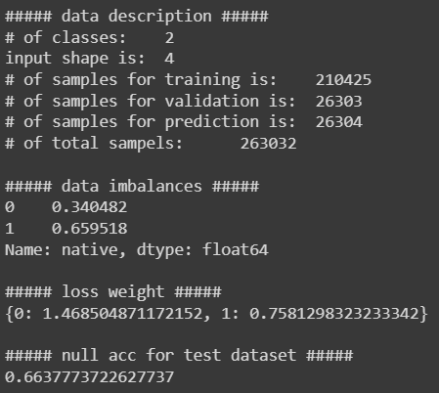
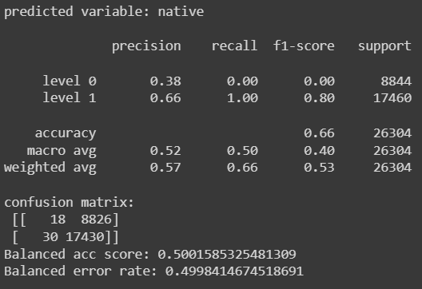
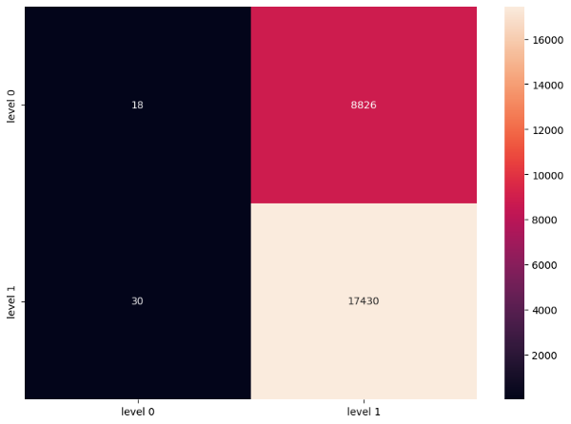
For Nativity
Null Accuracy = 0.66%
Logistic Regression = 0.66%

Slide 14
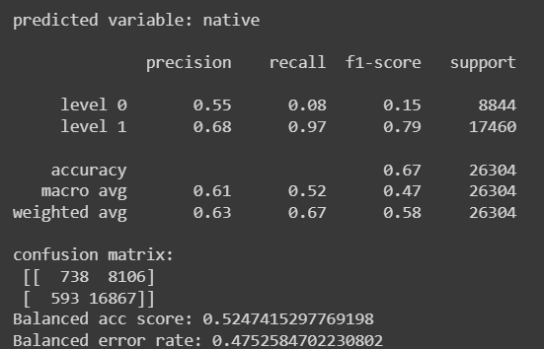
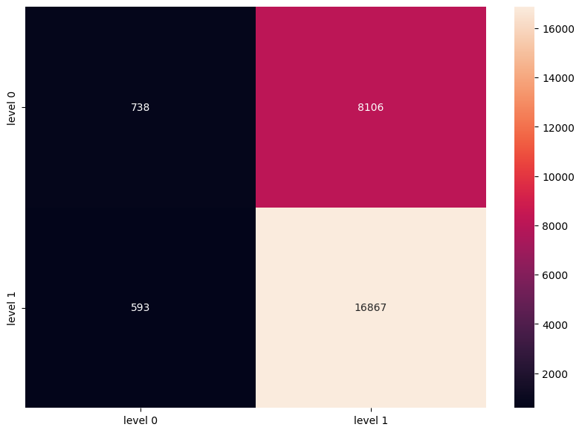
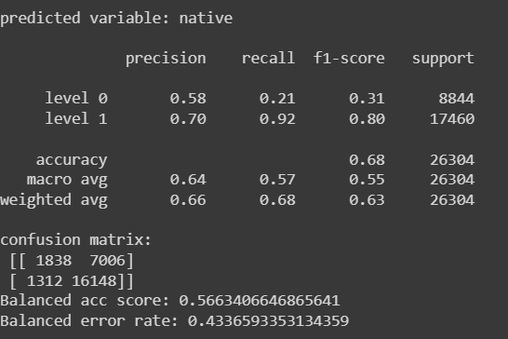
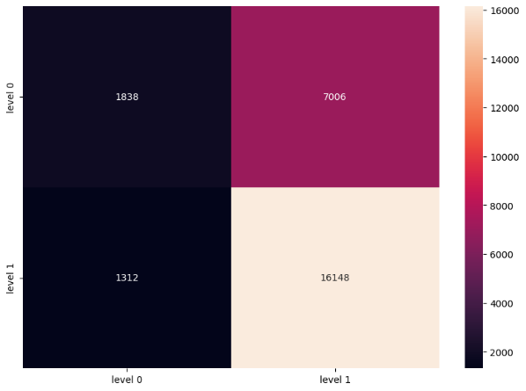
Decision tree = 0.67%
Random forest = 0.68%

Slide 15
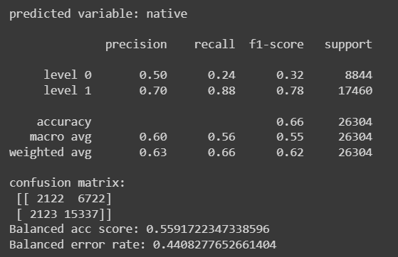
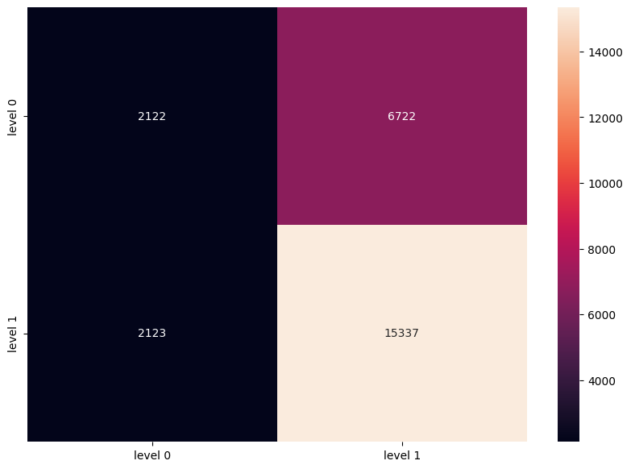
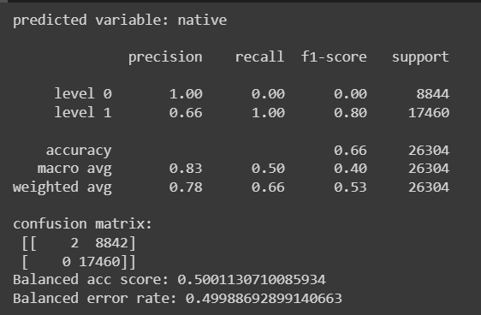

K – nearest neighbour = 0.66%
Naïve Bayes = 0.66%

Slide 16
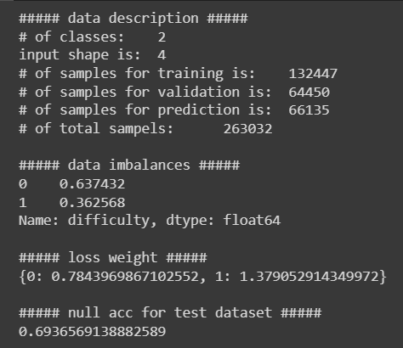
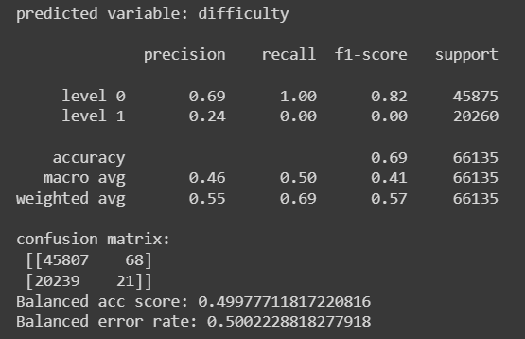

Predicting on New Reading Passages
For Difficulty
Null Accuracy = 0.69%
Logistic Regression = 0.69%

Slide 17
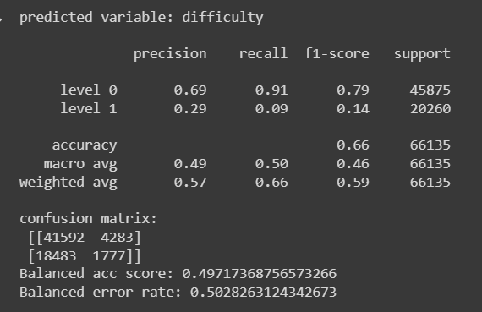
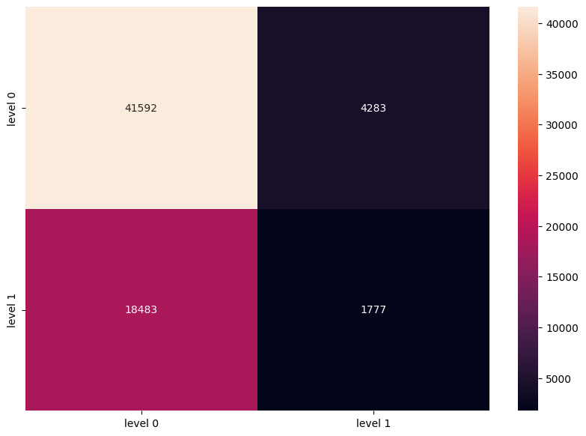
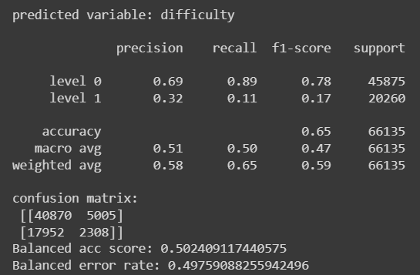

Decision tree = 0.66%
Random forest = 0.65%

Slide 18
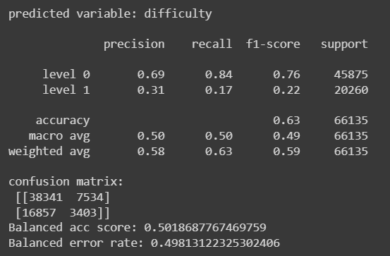

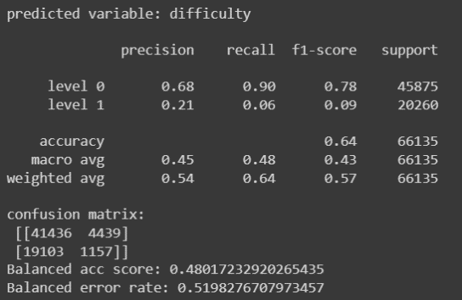

K – nearest neighbour = 0.63%
Naïve Bayes = 0.64%

Slide 19
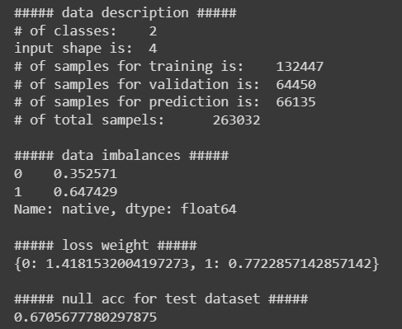
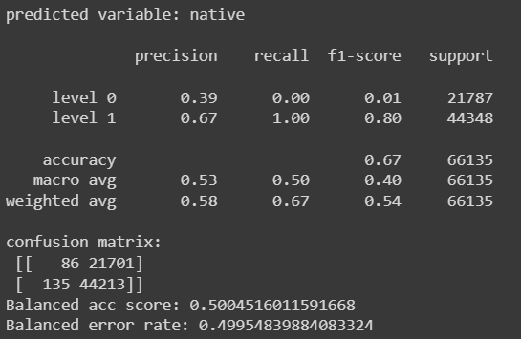

For Nativity
Null Accuracy = 0.67%
Logistic Regression =0.67%

Slide 20
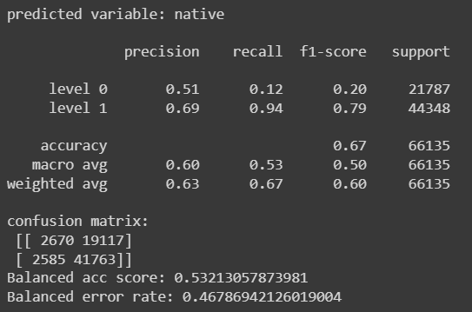

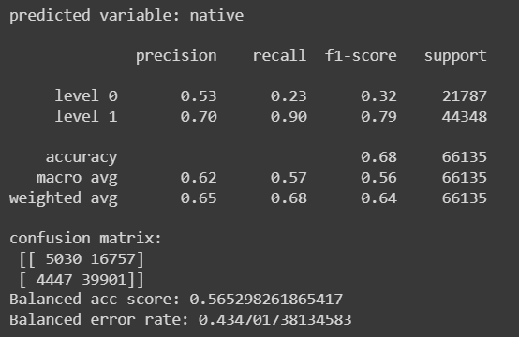

Decision tree = 0.67%
Random forest = 0.68%

Slide 21
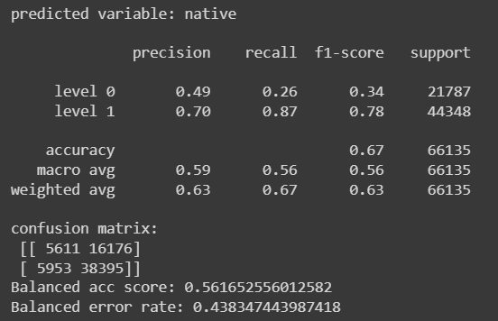

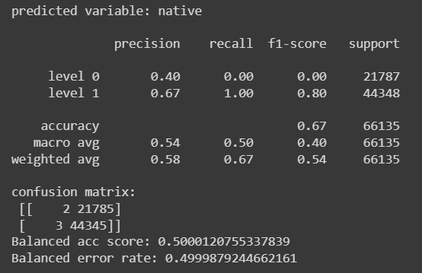

K – nearest neighbour = 0.67%
Naïve Bayes = 0.67%

Slide 22
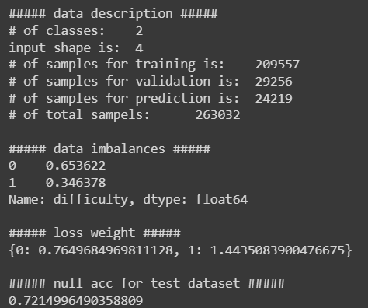
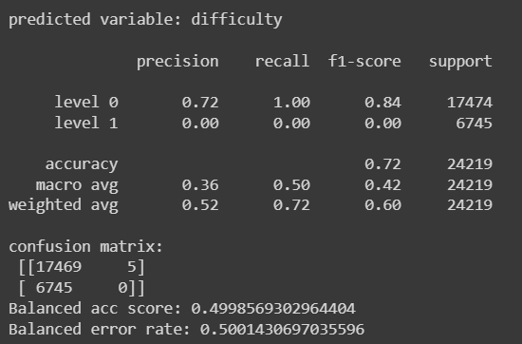
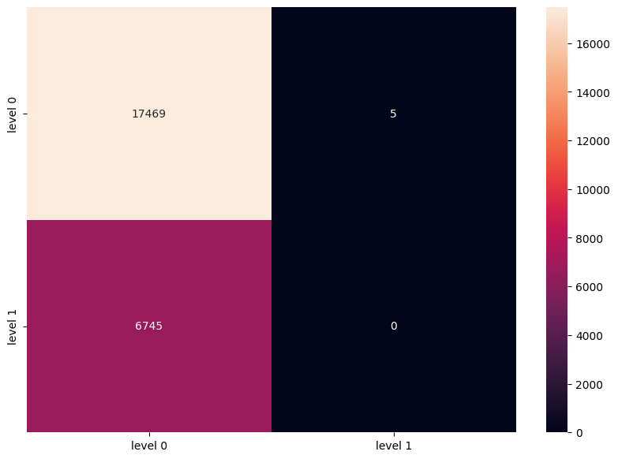
Predicting on New Reading Subjects
For Difficulty
Null Accuracy = 0.72%
Logistic Regression = 0.72%

Slide 23
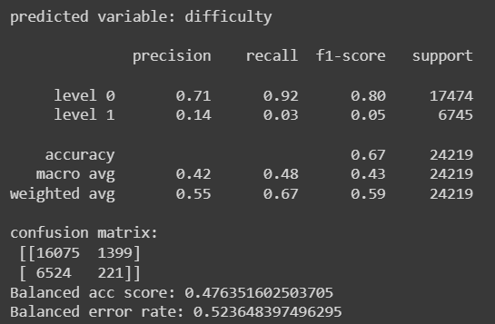

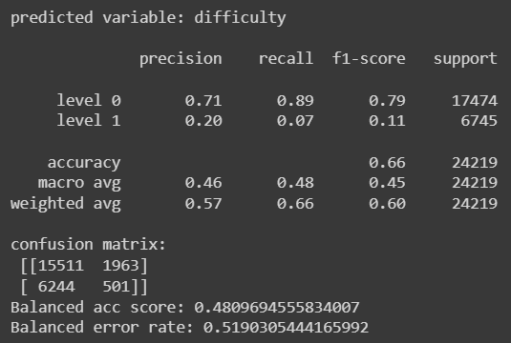

Decision tree = 0.67%
Random forest = 0.67%

Slide 24
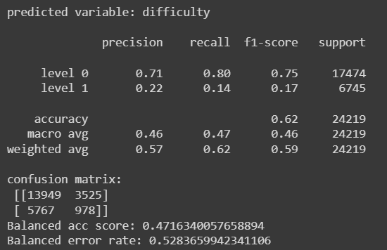
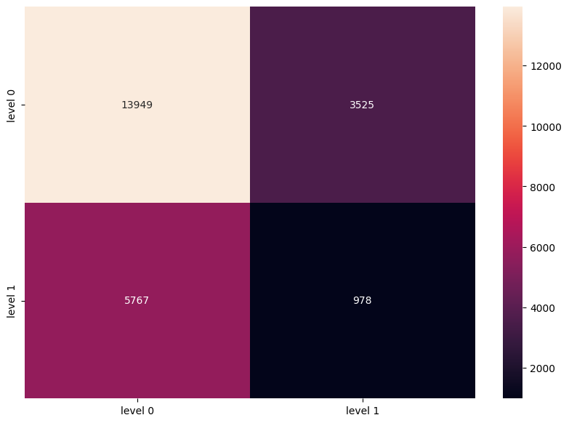
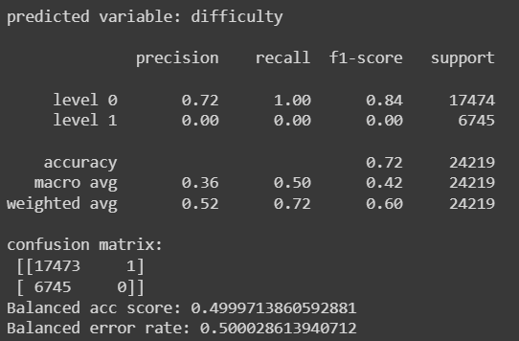

K – nearest neighbour = 0.65%
Naïve Bayes = 0.72%

Slide 25
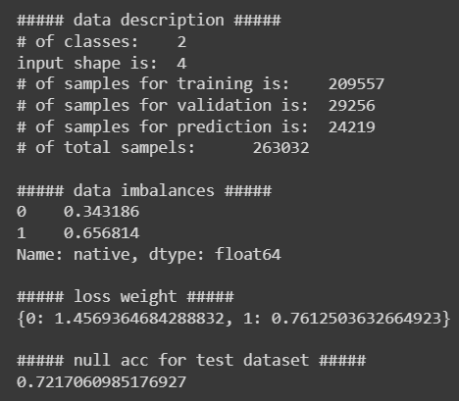
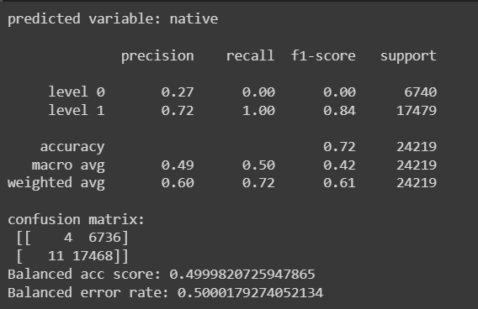
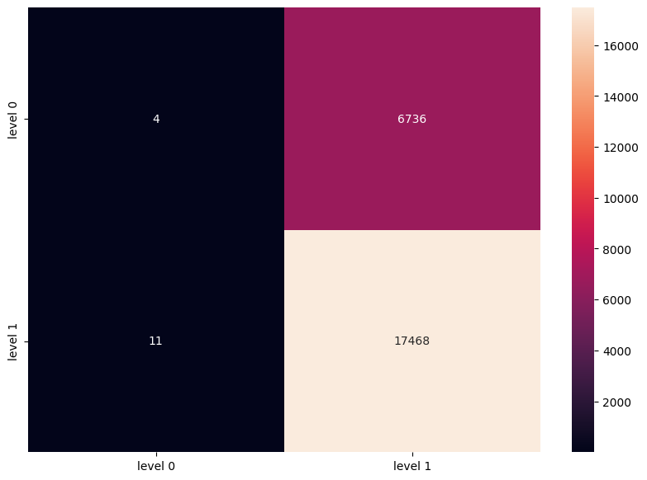
For Nativity
Null Accuracy = 0.72%
Logistic Regression = 0.72%

Slide 26
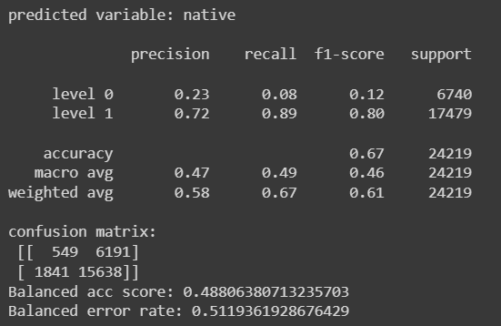

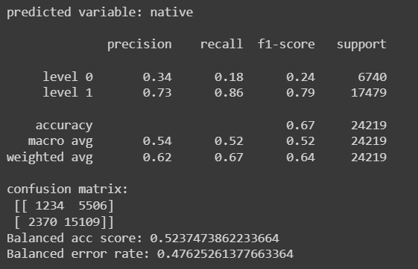

Decision tree = 0.67%
Random forest = 0.66%

Slide 27




K – nearest neighbour = 0.62%
Naïve Bayes = 0.72%

Slide 28
Accuracy Scores found for Difficulty variable
b – before fine-tuning, a – after fine-tuning
Algorithm | Accuracy_type | Subject_wise | Record_wise | Book_wise
Logistic Regression | Validation | 0.65774 | 0.66126 | 0.67322
 | Testing | 0.72129 | 0.66256 | 0.69295
Decision tree | Validation – b | 0.56375 | 0.57275 | 0.54537
 | Validation – a | 0.65812 | 0.66281 | 0.63
 | Testing | 0.67286 | 0.66382 | 0.65577
Random Forest | Validation – b | 0.62449 | 0.64263 | 0.59859
 | Validation – a | 0.65501 | 0.66787 | 0.62861
 | Testing | 0.66113 | 0.67073 | 0.65286
K-Nearest Neighbor | Validation – b | 0.5996 | 0.61423 | 0.5811
 | Validation – a | 0.63249 | 0.64278 | 0.61147
 | Testing | 0.61633 | 0.64663 | 0.63119
Naïve Bayes | GaussianNB | 0.65382 | 0.65704 | 0.63671
 | BernoulliNB | 0.65761 | 0.66122 | 0.636
 | Testing | 0.72146 | 0.66264 | 0.64403

Slide 29
Accuracy Scores found for Native variable
Algorithm | Accuracy_type | Subject_wise | Record_wise | Book_wise
Logistic Regression | Validation | 0.63074 | 0.65745 | 0.67351
 | Testing | 0.72142 | 0.66332 | 0.66983
Decision tree | Validation – b | 0.53182 | 0.59221 | 0.58313
 | Validation – a | 0.60165 | 0.66133 | 0.67564
 | Testing | 0.66836 | 0.66929 | 0.67185
Random Forest | Validation – b | 0.56248 | 0.66 | 0.65311
 | Validation – a | 0.58152 | 0.67988 | 0.67919
 | Testing | 0.6748 | 0.68377 | 0.67938
K-Nearest Neighbor | Validation – b | 0.55619 | 0.63704 | 0.62978
 | Validation – a | 0.57783 | 0.66377 | 0.65874
 | Testing | 0.65416 | 0.66374 | 0.6654
Naïve Bayes | GaussianNB | 0.63426 | 0.65149 | 0.67432
 | BernoulliNB | 0.62958 | 0.65764 | 0.67409
 | Testing | 0.72167 | 0.66385 | 0.67055

Slide 30
Final scores for Difficulty and Nativity variables
Prediction Variable | Difficulty |  |  | Native
 | Subject_wise | Record_wise | Book_wise | Subject_wise | Record_wise | Book_wise
Null Accuracy | 0.72 | 0.66 | 0.69 | 0.72 | 0.66 | 0.67
Logistic Regression | 0.72 | 0.66 | 0.69 | 0.72 | 0.66 | 0.67
Decision Tree | 0.67 | 0.66 | 0.65 | 0.67 | 0.67 | 0.67
Random Forest | 0.66 | 0.67 | 0.65 | 0.67 | 0.68 | 0.68
K-Nearest Neighbor | 0.62 | 0.65 | 0.63 | 0.65 | 0.66 | 0.67
Naive Bayes | 0.72 | 0.66 | 0.64 | 0.72 | 0.66 | 0.67

Slide 31
Discussion
Models gave good accuracies, in some cases, near to the null accuracies.
Performance of the logistic regression model and naive bayes model have better accuracies (equal to the null accuracies).
For new windows (record wise), there is no much improvement in the accuracies when compared to new readers and new passages.
Naive Bayes model shows the same trait like there is no much improvement in the accuracy after fine-tuning the model.
These machine learning models have better performance when compared to the sequential models of RNN and CNN.
The assumption that ground truth labels are assigned to local fixation windows based on the passage-level labels.
A feasible solution can be to learn a weighting of local features that optimizes global prediction.
The training, validation, and testing datasets for the same preliminary dataset differed; the resulting accuracies varied. Thus, the accuracies listed here may not be optimal.
The models' performances still needs to be improved and is to be worked upon.

Slide 32
Conclusion
These models are built to study and analyse approaches to classify a reader's comprehension level.
Mainly two prediction variables: the reader's difficulty and whether the reader is a native speaker of English.
Prediction on new passages, new readers, and new windows for both difficulty and native variables gives better performance when compared to previous RNN and CNN models.
Predictions on new windows for difficulty and native does not improve much from fine-tuning the model.
Model shows the difference in statistical testing and prediction.
Reading comprehension evaluation can be improved further by using the BERT model.
A pre-trained model of BERT can be taken and fine-tuned following our data to input the passages and assessment questions and answers, which in turn outputs the required assessment.
Thus, it concludes the working and implementation of the models for predicting reading comprehension from gaze behavior.

Slide 33
Thank you

